Slide 1
Wi-Fi automation lab Pre-lab tasks
Andreas Koksrud / Telenor Bedrift
Co-authors:
Kjetil Teigen Hansen & François Vergès

Slide 2
References / inspiration
References
https://github.com/CiscoDevNet/yangsuite/
https://postman.com
https://docs.ansible.com/ansible/latest/collections/cisco/ios/ios_facts_module.html
https://www.wifireference.com/2020/01/14/viewing-network-telemetry-from-the-catalyst-9800-with-grafana/
https://grafana.com/grafana/dashboards/13462-device-health-monitoring/
https://grafana.com/grafana/dashboards/12468-catalyst-9800-client-stats/
https://wirelessisfun.wordpress.com/2020/12/10/network-telemetry-data-and-grafana-part-1-the-advanced-netconf-explorer/
https://python.org
https://codeium.com
https://canonical.com/multipass
https://blog.apnic.net/

Slide 3
Copyright
Copyright
© Andreas Koksrud 2025. All rights reserved. This presentation is provided for educational and informational purposes only. You may distribute and learn from this presentation, but commercial use or any form of monetization is strictly prohibited without prior written consent
Any slides marked Kjetil Teigen Hansen or the Conscia logo will also have full or co-ownership by Kjetil
Any slides marked François Vergès or the SemFio logo will also have full or co-ownership by François

Slide 4
Prerequisites
Prerequisites
Cisco Meraki account (https://dashboard.meraki.com)
Juniper MIST account (https://manage.mist.com)
Postman account (https://postman.com)
Complete the pre-lab exercises (this document) before the deep dive labs
Bring an Ethernet dongle if you don't have built-in port
(optional) Bring an extra screen to show lab guide (or prepare to Alt-Tab)

Slide 5

Communications
Communications
WebEx space: Wi-Fi automation lab
Please help each other
Sharing is caring ☺

Slide 6
Agenda
Agenda
Pre-lab
Choose your hypervisor
Install Ubuntu Server w/Docker
Install Postman
Install VS Code
Day 1
Day 2
In-depth explore a topic of choice
Sort out pre-lab task problems
Grafana / TIG-stack
Grafana Cloud
Ansible
Python
Cloud vendor automation (MIST or Meraki)
Get to know the lab environment
Connect VS Code to Ubuntu
Install and explore Ansible
Explore Python automation
Install and explore YANG Suite
Explore Postman
Install and explore Grafana
(optional) install 9800-CL

Slide 7
Scope
Scope
In scope
Getting started with various systems/languages/solutions for lab purposes
Set up your own Ubuntu Linux server on your own laptop. It will be possible to use a shared server if you do not want or have possibility to install an Ubuntu VM on your laptop
Some nice examples to try various aspects of automation
Inspiring you to explore deeper on your own
Out of scope topics
Git
Learning the languages (Ansible, Python, InfluxQL, etc)
Learning Linux
Deploying the systems for production use
Troubleshooting WLC/AP connection

Slide 8
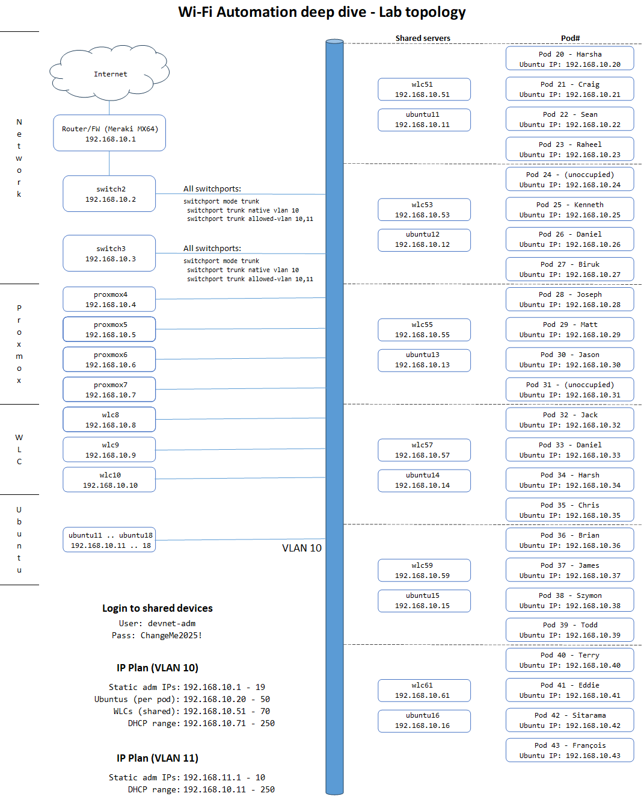

Lab topology
Each student have an assigned Pod number. When using static IP, their Ubuntu Server should have the same last octet as the Pod#
2 students share a preconfigured WLC, as assigned in the topology map
Everyone is connected to VLAN 10
All switchports on all switches are trunk ports with VLAN 10 as native, and allowed vlan as VLAN 10 and 11
For Wi-Fi clients on your SSIDs you can use VLAN 11 to not fill up VLAN 10

Slide 9
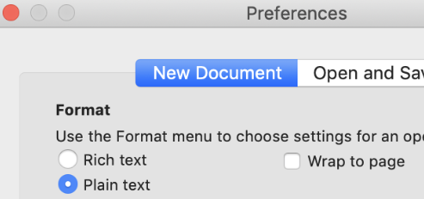
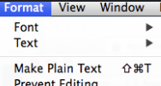
Notes for Mac users - TextEdit
Notes for Mac users
TextEdit (the default text editor on OS X) use rich text formatting by default. This is not a great idea when copy-pasting stuff to the command line, so there is a couple of things you must keep in mind
If you want, you can change a setting in TextEdit to make all new documents plain text
To change the current document to plain text go to Format -> Make Plain Text
Shortcut is: Shift-Cmd-T

Slide 10
Notes for WSL users (alternative, untested yet)
Notes for WSL users
You can use WSL (Windows Subsystem for Linux) instead of a Ubuntu VM running in a hypervisor, for Python and Ansible stuff
TIG stack and other docker stuff is not tested (yet)
No instructions for using WSL or adopting the lab guide to WSL is included at this moment
Install WSL (start Powershell as administrator)
Check WSL version
Upgrade WSL
Install Ubuntu, run "wsl --install -d Ubuntu
List installed WSL VMs, run "wsl --list"
Fix network connectivity (from Powershell. Restart WSL)
You might have to create some FW-openings and/or do some port forwarding to get the external devices (like the 9800 WLC) to communicate into your WSL Telegraf etc
PS C:\> echo '[wsl2]' > ~\.wslconfig
PS C:\> echo 'networkingMode=mirrored' >> ~\.wslconfig
PS C:\> wsl --install
PS C:\> wsl --version
WSL version: 2.3.24.0
(... if this command is not showing version, you must upgrade)
PS C:\> wsl --update
PS C:\> wsl --install -d Ubuntu
PS C:\> wsl --list

Slide 11
Building your own lab
Building your own lab
Based on feedback from running this deep dive on previous events, if you are going to build and troubleshoot the full lab setup, it will take most or all of the time (2x 3h)
The deep dive itself will have pre-built and pre-configured+tested WLAN Controllers (1 WLC per 2-4 students) for you to use. If you want to install your own WLC by following the optional part of this pre-lab guide that is OK, but we strongly encourage you to use the deep dive time to do actual automation exercises and not troubleshooting your WLC
There will also be pre-built Ubuntu servers to use, running on our servers, for those who want to use that instead of their own laptop.
If you have a mini computer or an old laptop to spare, you could install Proxmox on that and use for your VMs. Unfortunately it is outside the scope of this deep dive and this pre-lab guide to give detailed instructions on the Proxmox installation itself, outside what is described in task 1d. It is also outside the scope of the deep dive to help troubleshoot your Proxmox. But our servers run on that, so we are somewhat familiar with it and might answer some simple questions ☺
We will also provide pre-built images with a finished installation of Ubuntu Server for Hyper-V and Virtualbox
We encourage you to install your own Ubuntu Server, since it will give you more experience building the items yourself when you get home or need it in some other situation.

Slide 12
Pre-lab task #1: Choose your Hypervisor
Pre-lab task #1: Choose your hypervisor
The lab itself will use 9800 WLCs that already run on our servers, which have Proxmox Virtual Environment installed. That is a Level 1 hypervisor (run directly on the hardware)
This chapter will have separate instructions for using Hyper-V (1a), VirtualBox (1b), Multipass/qemu (1c) and Proxmox (1d). Corresponding instructions will also be given in chapter 2 (a/b/c/d) for Ubuntu Server installation, and chapter 6 (a/b/d) for WLC 9800-CL installation
On Mac, 9800-CL will not be possible, so Mac users will either need a separate server, or (preferrably) use our pre-built (and tested) 9800-CL installations
Hyper-V (on Windows), VirtualBox and VMWare Workstation and Fusion are examples of level 2 hypervisors. That mean that they are running on top of another OS. They will be slower than level 1 hypervisors like Proxmox, Nutanix, VMWare ESXi, Hyper-V server etc. There are some differences between how long the "path to the hardware" is, which might explain some differences in speed using the alternatives.
!!! Note !!!
You should turn OFF power save stuff on your laptop, as you might run into unexpected problems if your laptop enters power saving mode
You should always do a shutdown of your VMs before shutting down or putting your laptop in sleep or hibernation mode. Especially the 9800-CL do NOT like if the host OS sleeps, and might be corrupt so you have to reinstall the WLC

Slide 13
Pre-lab task #1: Choose your Hypervisor
Pre-lab task #1: Choose your hypervisor
My experience is that on Windows, virtual machines in Hyper-V are faster than in VirtualBox. This might be due to suboptimal config, differences in hardware, or that Hyper-V have a shorter "path to the hardware"
If you have no preference, this is my recommendation for this deep dive:
If you use Windows: Install Ubuntu Server in Hyper-V
If you use Mac: Install Ubuntu Server using Multipass (w/qemu)
WLC 9800-CL: Use our shared pre-built & tested servers referring to your Pod# in the Lab Topology map
For the rest of this chapter, and for chapter 2, follow the instructions for your chosen hypervisor
!!! Note - Many of these instructions require admin privileges. You should be in control of what you do so you don't break anything. We can give no guarantees. The instructions and screenshots are from the working solution on our own laptops, but we have no way to tell if it works on all setups and which conflicting software you might heave. If you do not want to do this on your laptop, you can use our pre-built and tested Ubuntu Servers and WLCs !!!

Slide 14

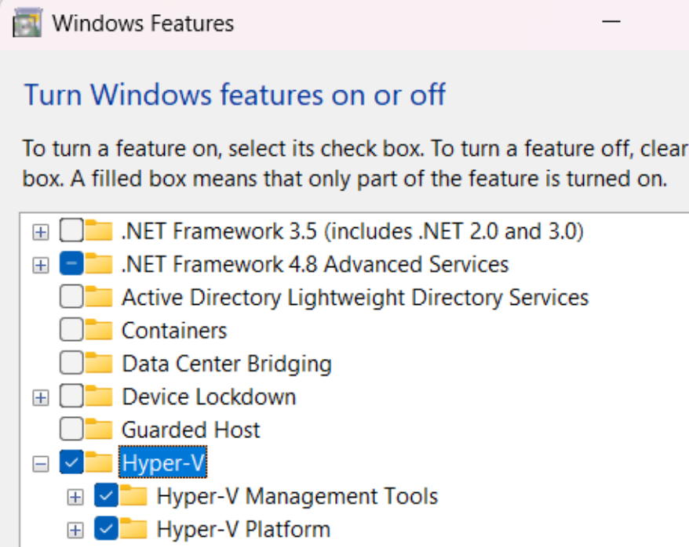
Pre-lab task #1a: Hyper-V
Pre-lab task #1a: Hyper-V
If you want to use Hyper-V on Windows as your hypervisor, follow this task. When done, jump to task 2a, for how to install Ubuntu on Hyper-V.
Hyper-V can also run WLC 9800-CL. If you want to try this, you can follow the steps in the optional task 6a
Full instructions on how to enable/install Hyper-V, or to troubleshoot this, is outside the scope of this lab guide. But in short, go to "Turn Windows Features on or off" and enable Hyper-V
Reference: https://learn.microsoft.com/en-us/virtualization/hyper-v-on-windows/quick-start/enable-hyper-v#enable-the-hyper-v-role-through-settings

Slide 15
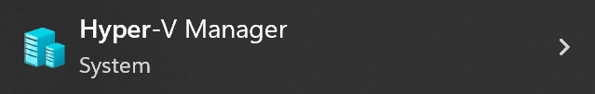
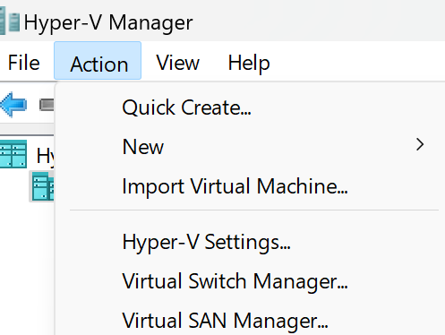
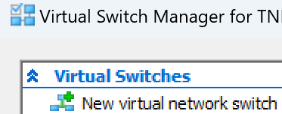
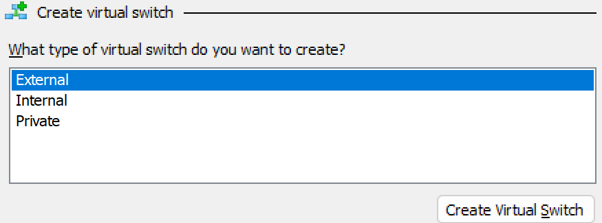
Pre-lab task #1a: Hyper-V - Virtual Switch Manager
Pre-lab task #1a: Hyper-V
Start by opening Hyper-V manager from the Start Menu
To create virtual switches (Networks) to connect your Ubuntu and 9800-CL, select "Virtual Switch Manager…"
You want to create an "External" switch. This is similar to "Bridged Adapter" in VirtualBox.

Slide 16
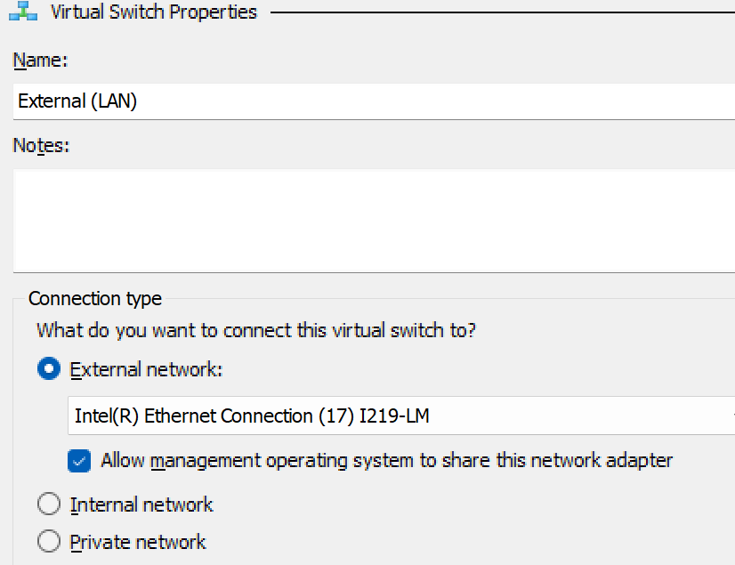
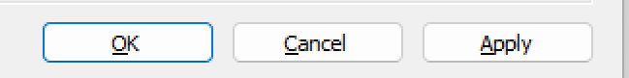
Pre-lab task #1a: Hyper-V - Virtual Switch Manager
Pre-lab task #1a: Hyper-V
Create the external switch as shown on the screenshot
Use a descriptive name
Select your wired ethernet adapter
Enable this setting
Click OK

Slide 17
Pre-lab task #1b: VirtualBox
Pre-lab task #1b: VirtualBox
If you want to use VirtualBox on Windows as your hypervisor, follow this task. When done, jump to task 2b, for how to install Ubuntu on VirtualBox
VirtualBox can also run WLC 9800-CL. If you want to try this, you can follow the steps in the optional task 6b
RightCtrl + F switches between full-screen and window
Tap RightCtrl to "free" input from guest

Slide 18
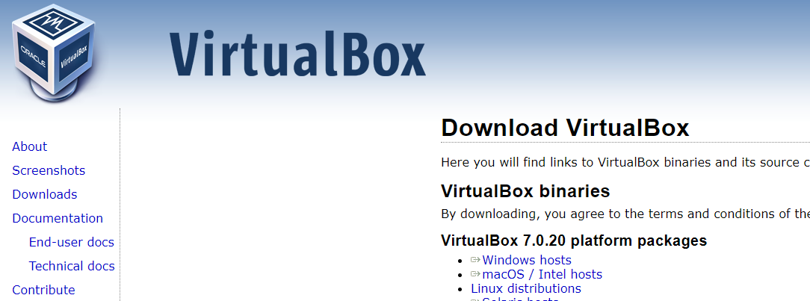
VirtualBox installation
Pre-lab task #1b: VirtualBox
https://virtualbox.org/
Needs admin privileges
Not all steps are shown here, it is mostly "Next-next-next"
As default folder for VMs, I use "C:\Virtual Machines", you can use whatever, but screenshots here will show this path

Slide 19
VM Networking
Pre-lab task #1b: VirtualBox
Here is a general overview of different modes of networking
Bridged Adapter (used in this lab)
Each VM gets an IP alongside your host, directly on the network
Switchports must accept multiple mac addresses from each host
For APs to connect to 9800, I prefer this rather than NAT'ing through your host
Also, for WLCs to connect to Ubuntu (for telemetry), I also prefer this over NAT'ing
NAT Network (not covered in this lab)
Host IP is shared as outside IP
VMs get IP addresses on a NAT’ed network pool
NAT Network is created under File -> Tools -> Network Manager -> NAT Networks
You must create Port Forwarding rules (in the NAT Networks config) to allow traffic from host to guest VMs
NAT (not covered in this lab)
Host IP is shared as outside IP
VM can only reach internet, not the other VMs
Host and guest can not reach each other on IP, only the VirtualBox console

Slide 20
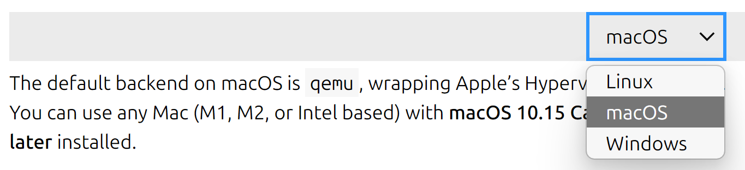
Pre-lab task #1c: Multipass (Mac)
Pre-lab task #1c: Multipass (Mac)
On Mac we recommend using Canonical Multipass for deploying the Ubuntu Server. It will use qemu as backend. Follow this task to install Multipass and jump to task 2c, for how to install Ubuntu. Qemu should be enabled on Mac as default
Full instructions on how to install Multipass, or to troubleshoot this, is outside the scope of this lab guide. But the tutorial in this link are very good: https://canonical.com/multipass/docs/install-multipass
Select "macOS" in the drop down menus

Slide 21
Pre-lab task #1c: Multipass (Mac)
Pre-lab task #1c: Multipass (Mac)
Verify that Multipass is installed and working
Once multipass is installed, you can launch an Ubuntu server with this command. You can test this if you want, or you can skip to section 2c where you will install the server to use in the deep dive with some more options like memory, disk, cpu, networking etc
To list your servers
Start, connect to shell, stop and delete your servers
akoksrud:MacOS ~$ multipass --version
multipass 1.15.0+mac
multipassd 1.15.0+mac
akoksrud:MacOS ~$ multipass launch --name testserver
Launched: testserver
akoksrud:MacOS ~$ multipass list
Name State IPv4 Image
ubuntu-devnet Running 192.168.64.9 Ubuntu 24.04 LTS
akoksrud:MacOS ~$ multipass start ubuntu-devnet
akoksrud:MacOS ~$ multipass shell ubuntu-devnet
akoksrud:MacOS ~$ multipass stop ubuntu-devnet
akoksrud:MacOS ~$ multipass delete ubuntu-devnet
akoksrud:MacOS ~$ multipass purge

Slide 22
Pre-lab task #1c: Multipass (Mac)
Pre-lab task #1c: Multipass (Mac)
Instruct Multipass to use your wired adapter as bridge adapter. Using wireless adapter with or without bridging is also possible, but for the deep dive lab it will be less room for error if you stick with wired for now
Continue to section 2c where we will use the bridged adapter when we create a Ubuntu Server
akoksrud:MacOS ~$ multipass networks
Name Type Description
en0 wifi Wi-Fi
en4 ethernet Ethernet Adapter (en4)
en5 ethernet Ethernet Adapter (en5)
akoksrud:MacOS ~$ multipass set local.bridged-network=en4

Slide 23


Pre-lab task #1d: Proxmox (separate hardware)
Pre-lab task #1d: Alternative solutions - Proxmox
If you want to use Proxmox as your hypervisor, follow this task. When done, jump to task 2d, for how to install Ubuntu on Proxmox
The "portable datacenter" that run the student VMs in this lab, run on Proxmox Virtual Environment
If you have an old laptop (with sufficient RAM, disk and CPU), or maybe an Intel NUC or other mini computer, this is an excellent alternative
Full instructions on how to install Proxmox, or to troubleshoot this, is outside the scope of this lab guide. For installation instructions, see https://proxmox.com/
For production use, licenses should be aquired. For lab work, support won't be that critical, so you could run without license. Proxmox itself is open source, but the company earns their well deserved cash by offering various levels of support agreements/licensing. You will get this box each time you log in to to the proxmox web page

Slide 24
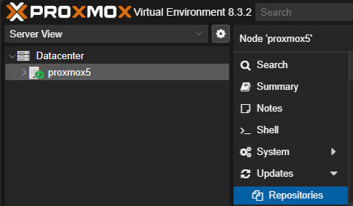
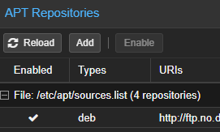
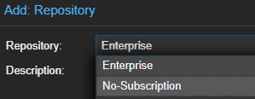
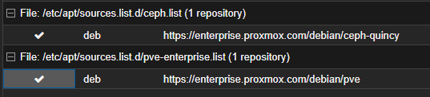
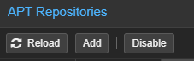
Pre-lab task #1d: Proxmox - Enable NoSub repo
Pre-lab task #1d: Alternative solutions - Proxmox
To update/upgrade Proxmox (without subscription / Community Edition), go to your node {server name} -> Updates -> Repositories
Then Add the No-Subscription repository
Disable the two enterprise repositories
You can then update from GUI or from CLI
root@proxmox5:~$ apt update
root@proxmox5:~$ apt upgrade

Slide 25
Pre-lab task #2: Ubuntu Server
Pre-lab task #2: Ubuntu Server
Like the first section, this is also separated into specific instructions for installing Ubuntu Server on
2a. Hyper-V
2b. VirtualBox
2c. Parallels
2d. Proxmox
Follow the instructions for your hypervisor, and skip the others
!!! After the hypervisor-specific instructions, there are common instructions which are identical no matter which hypervisor you are using !!!

Slide 26
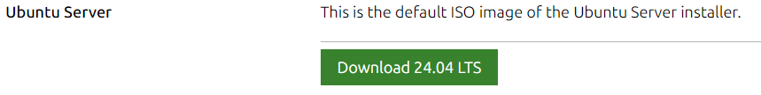
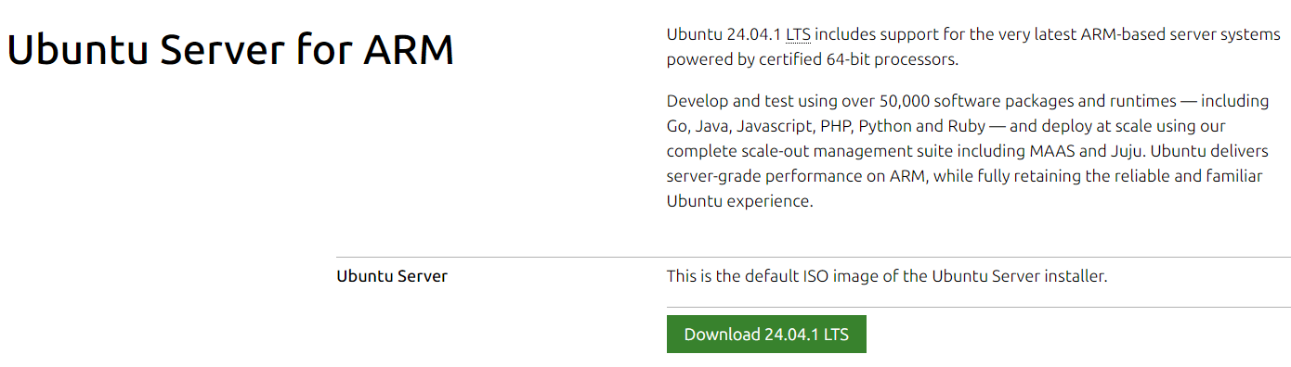
Pre-lab task #2: Download Ubuntu Server
Pre-lab task #2: Ubuntu Server
Hyper-V, VirtualBox and Proxmox: Download Ubuntu Server 24.04 (default ISO image)
https://ubuntu.com/download/server
Mac with Apple M-series CPU: Download "Ubuntu Server for ARM"
https://ubuntu.com/download/server/arm

Slide 27
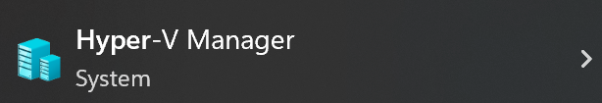
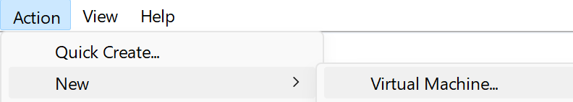
2a: Hyper-V: Create Virtual Machine
Pre-lab task #2: Ubuntu Server
Open "Hyper-V Manager"
Action -> New -> Virtual Machine…

Slide 28
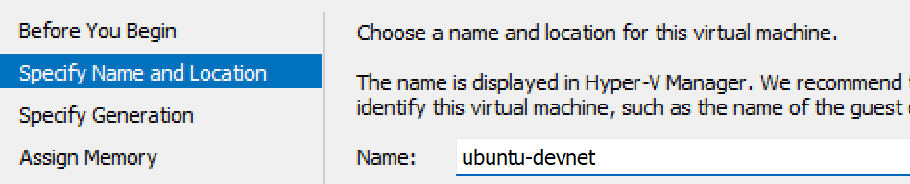
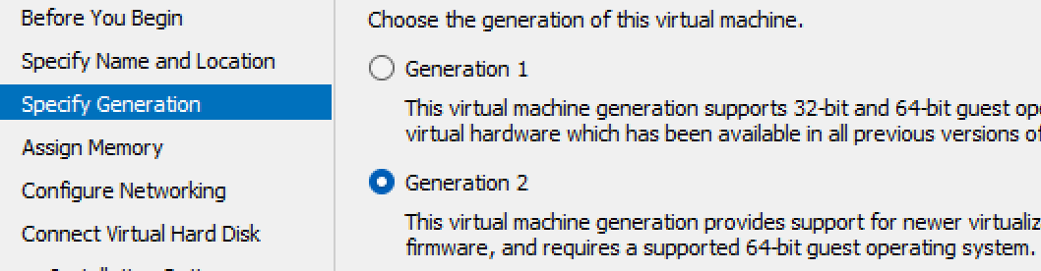
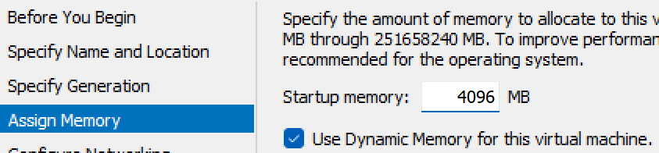
2a: Hyper-V: Create Virtual Machine
Pre-lab task #2: Ubuntu Server
Click past the first page. On page 2, specify a name. Click Next
Specify Generation: Generation 2
Assign 4GB memory

Slide 29
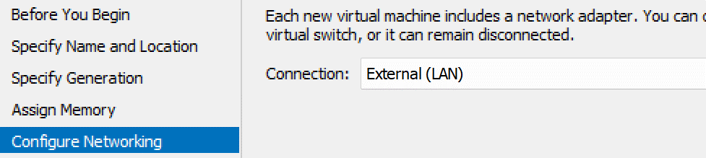
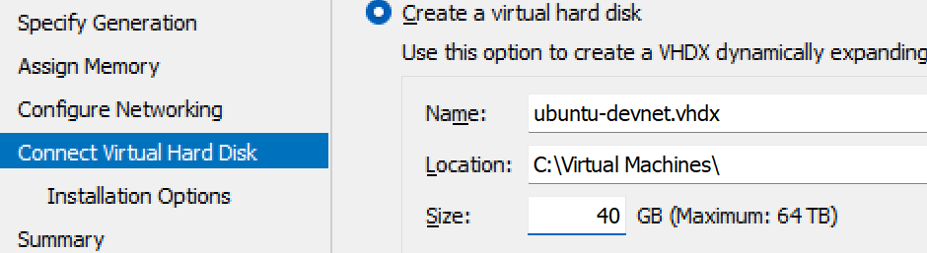
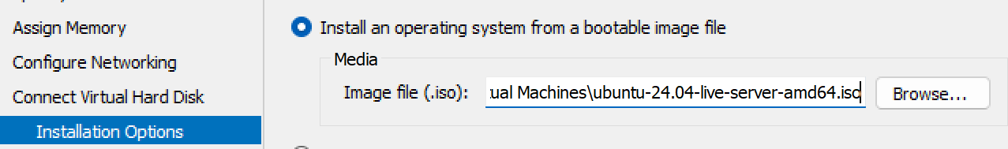
2a: Hyper-V: Create Virtual Machine
Pre-lab task #2: Ubuntu Server
On Configure Networking, select the "External (LAN)" vSwitch you created in task 1a
For Hard Disk, create a VHDX disk with 40GB
Installation Options: Use the Ubuntu Server ISO image you downloaded. Then click "Finish"

Slide 30
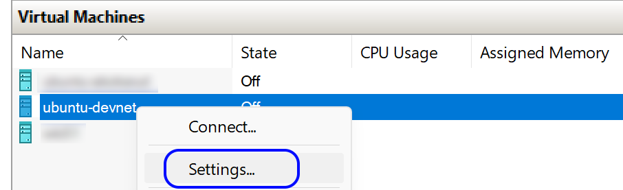
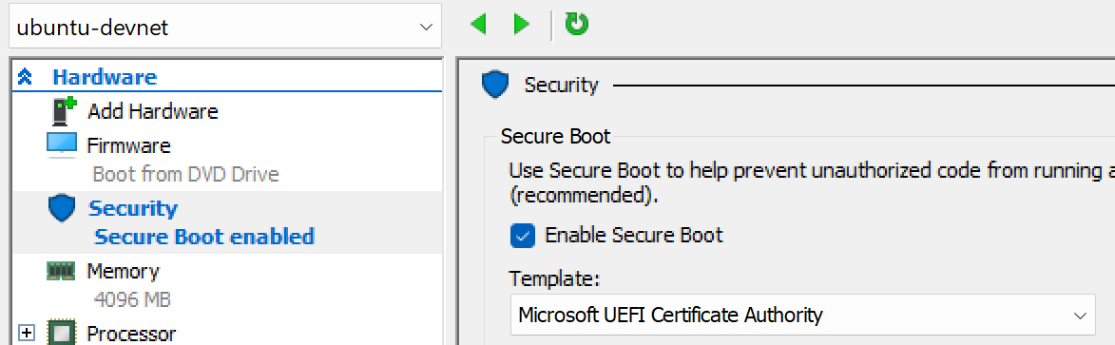
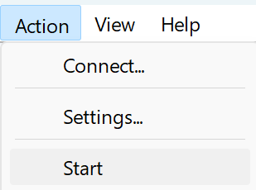
2a: Hyper-V: Create Virtual Machine
Pre-lab task #2: Ubuntu Server
Right click you new machine, and select "Settings…"
Under "Security" select Template: Microsoft UEFI Certificate Authority
Start your machine, then skip some slides forward to the common instructions ☺

Slide 31

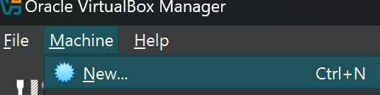
2b: VirtualBox: Create Virtual Machine
Pre-lab task #2: Ubuntu Server
Open VirtualBox
Macine -> New

Slide 32
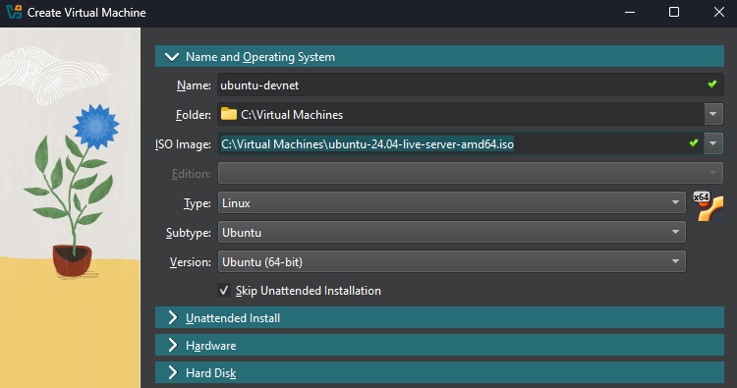
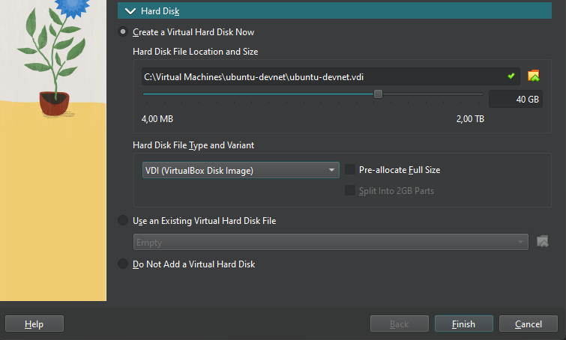
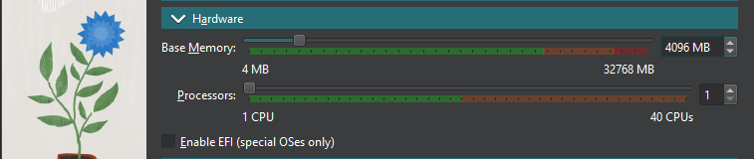
2b: VirtualBox: Create Virtual Machine
Pre-lab task #2: Ubuntu Server
Set the name, folder and select the ISO that you downloaded
Select Type as shown
Check «Skip Unattended Installation»
Expand the «Hardware» section. Increase to 4096MB
Expand the «Hard Disk» section. Increase to 40GB, then Finish

Slide 33
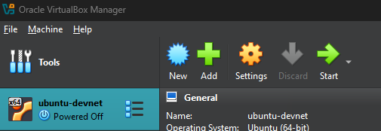
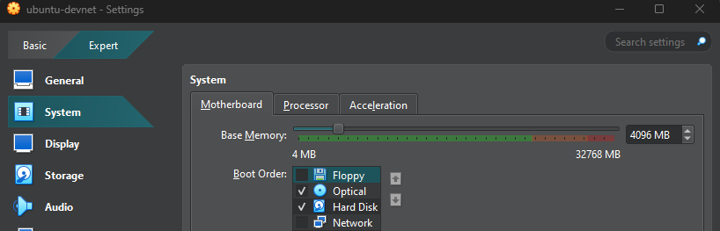
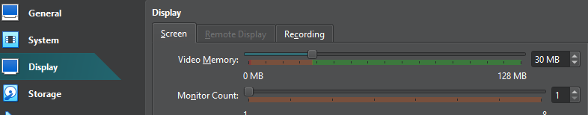
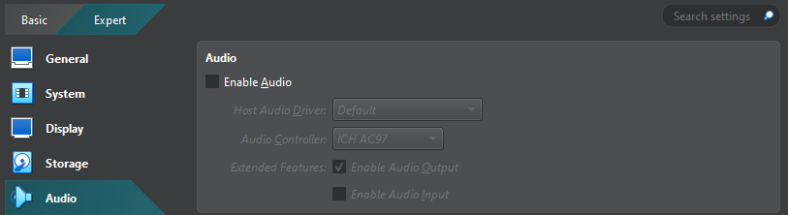
2b: VirtualBox: Create Virtual Machine
Pre-lab task #2: Ubuntu Server
Enter settings
General: No change needed
System: Remove «Floppy» checkbox. Keep the rest default
Display: Ensure «Video Memory» is at least 30MB. Keep the rest default
Storage: No change needed
Audio: Remove «Enable Audio» checkbox

Slide 34
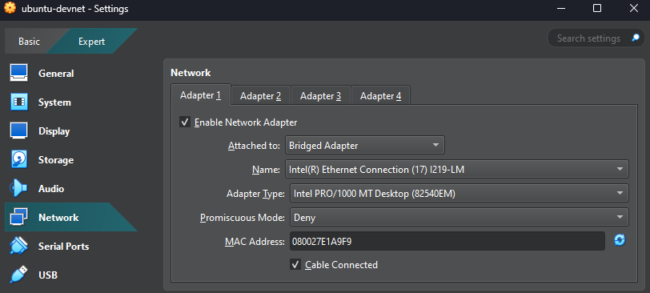
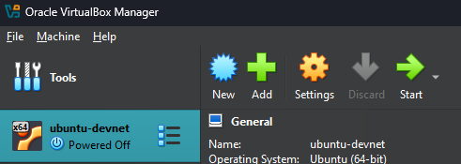
2b: VirtualBox: Create Virtual Machine
Pre-lab task #2: Ubuntu Server
Network:
Change «Attached to» for Adapter 1 to «Bridged Adapter»
Change «Name», select your Ethernet adapter
Keep the rest as default
Do not enable Adapater 2, 3 or 4
Click OK to save the changes
Start the VM
(here you can also choose «Headless Start» at a later stage when your VM have got its static IP so you would only use SSH)
Then, skip some slides forward to the common instructions ☺

Slide 35
2c: Multipass - Create VM
Pre-lab task #2: Ubuntu Server
~/ubuntu-devnet/cloud-config.yaml
users:
- default
- name: devnet-adm
lock_passwd: false
sudo: ALL=(ALL) NOPASSWD:ALL
plain_text_passwd: ChangeMe2025!
shell: /bin/bash
ssh_pwauth: True
package_update: true
package_upgrade: true
First, create a file on your laptop, named "cloud-config.yaml"
From the same folder you created the YAML file, create the server using the following command
List your VMs
Show VM info
akoksrud@MacOS:~/$ mkdir ubuntu-devnet
akoksrud@MacOS:~/$ cd ubuntu-devnet
akoksrud@MacOS:~/ubuntu-devnet$ nano cloud-config.yaml
akoksrud@MacOS:~/ubuntu-devnet$ multipass launch --name ubuntu-devnet --bridged --memory 4G --disk 40G --cpus 2 --cloud-init cloud-config.yaml
Creating ubuntu-devnet /
Configuring ubuntu-devnet /
Starting ubuntu-devnet /
If your IPv4 says "N/A", you must enter the DNS info in your hosts file manually. See next page.
Info will not show either, only throw a "Failed to resolve" error message.
Primarily seen when running Multipass on Windows. See next page for instructions
akoksrud@MacOS:~/ubuntu-devnet$ multipass list
Name State IPv4 Image
ubuntu-devnet Running 192.168.10.163 Ubuntu 24.04 LTS
akoksrud@MacOS:~/ubuntu-devnet$ multipass info ubuntu-devnet
Name: ubuntu-devnet
State: Running
(…)

Slide 36
2c: Multipass - Update hosts file (Windows)
Pre-lab task #2: Ubuntu Server
IF you get error message on multipass info, you need to update your hosts file. This is only seen on Windows. Multipass list will show "N/A" on IPv4 address
Find the IP of the VM. On Windows you can open the console of the VM
Open your text editor (Notepad++ in the example) as administrator. Open the file C:\Windows\System32\drivers\etc\hosts.ics and add this line (change the IP to your IP, and the hostname to what multipass tries to look up)
PS ~/ubuntu-devnet> multipass list
Name State IPv4 Image
ubuntu-devnet Running N/A Ubuntu 24.04 LTS
PS ~/ubuntu-devnet> multipass info ubuntu-devnet
info failed: ssh connection failed: 'Failed to resolve hostname ubuntu-devnet.mshome.net (No such host is known. )'
PS ~/ubuntu-devnet> vmconnect.exe $env:computername ubuntu-devnet
(…new window will open…)
ubuntu-devnet login: devnet-adm
Password: ChangeMe2025!
(…cut…)
Memory usage: 7% IPv4 address for eth1: 192.168.10.163
(…cut…)
devnet-adm@ububtu-devnet:~$ exit
192.168.10.163 ubuntu-devnet.mshome.net

Slide 37
2c: Multipass - Connect to shell
Pre-lab task #2: Ubuntu Server
Connect using SSH
Connect to the shell
Follow the relevant parts of the common Ubuntu Server installation instructions. You can of course skip the installation procedure itself, but be sure to do the parts regarding
Change keyboard layout
Change to static IP
Create and import SSH key
Clone the example git repository
Change to YOUR Ubuntu IP
akoksrud@MacOS:~/ubuntu-devnet$ ssh devnet-adm@192.168.10.163
devnet-adm@192.168.10.163's password: ChangeMe2025!
Welcome to Ubuntu 24.04.1 LTS (GNU/Linux 6.8.0-51-generic x86_64)
(…)
ubuntu@ubuntu-devnet:~$ exit
akoksrud@MacOS:~/ubuntu-devnet$ multipass shell ubuntu-devnet
Welcome to Ubuntu 24.04.1 LTS (GNU/Linux 6.8.0-51-generic x86_64)
(…)
ubuntu@ubuntu-devnet:~$ exit

Slide 38
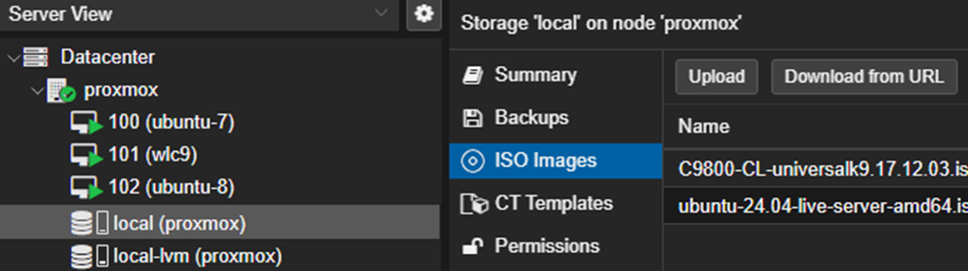
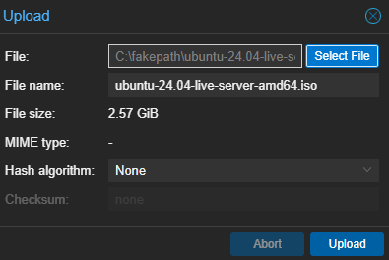
2d: Proxmox - Create Virtual Machine
Pre-lab task #2: Ubuntu Server
Open the Proxmox website (https://{IP}:8006)
Start by uploading the Ubuntu Server ISO to the Proxmox datastore: Go to Datacenter>proxmox>local (proxmox) Select "ISO images" and "Upload"

Slide 39
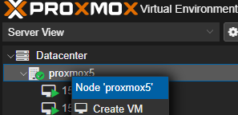
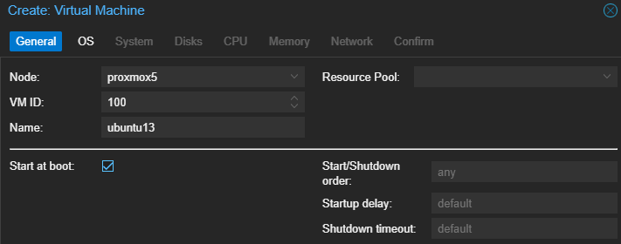
2d: Proxmox - Create Virtual Machine
Pre-lab task #2: Ubuntu Server
Right click your proxmox node, and "Create VM"
Set the name and if it should start on Proxmox boot

Slide 40
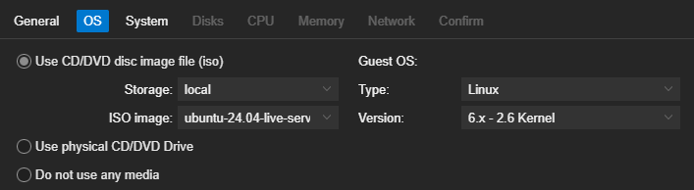
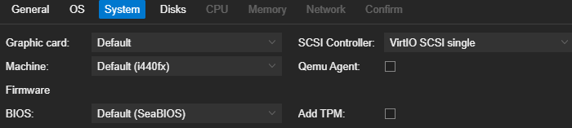
2d: Proxmox - Create Virtual Machine
Pre-lab task #2: Ubuntu Server
Under OS, select the ISO image
Under System keep the defaults

Slide 41
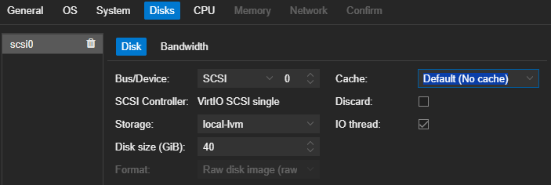
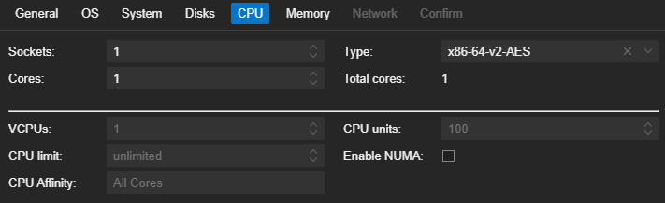
2d: Proxmox - Create Virtual Machine
Pre-lab task #2: Ubuntu Server
Under Disks, change to 40GB
Under CPU keep the defaults, if you have lots of available resources you could increase the number of cores to 2 or 4

Slide 42
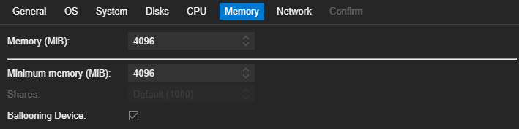
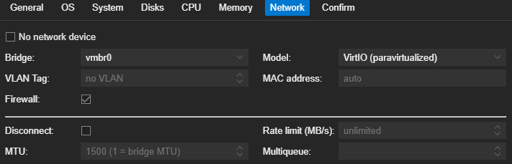

2d: Proxmox - Create Virtual Machine
Pre-lab task #2: Ubuntu Server
Under Memory, change to 4096MiB If you have limited resources, it would work fine with 2048MiB as well
Under Network, select vmbr0
Confirm and start your VM

Slide 43

2d: Proxmox - Create Virtual Machine
Pre-lab task #2: Ubuntu Server
Confirm and start your VM
Connect to the Console of your VM, to install the OS. Right click your VM and select "Console"

Slide 44
Ubuntu server install - Common instructions
Pre-lab task #2: Ubuntu Server
!!! The following slides are common steps, regardless of the hypervisor you use to run Ubuntu Server !!!
If you have installed using a method which skips the installation procedure here (e.g. Multipass, or copying a pre-installed VM host etc), just skip the irrelevant slides, but be sure to at least consider the steps regarding language, ssh keys etc

Slide 45



Ubuntu server install
Pre-lab task #2: Ubuntu Server
Frequent updates to Ubuntu can make the following pages somewhat different, but the basics should be recognizable.
If asked to update the installer you can do this, it won’t really matter much
Choose your own keyboard layout (unless you just love the norwegian æøå characters and funky placement of all the useful characters like dash and slash)
To change keyboard layout later
sudo dpkg-reconfigure keyboard-configuration

Slide 46



Ubuntu server install - Network configuration
Pre-lab task #2: Ubuntu Server
Later, when you are connected to the lab network at the deep dive, you will change the IP address to a static IP. You will also want to do this when you have it in your own lab.
Leave the proxy address blank
Testing the network connection

Slide 47




Ubuntu server install - Disk usage
Pre-lab task #2: Ubuntu Server
!!! When you encounter the disk usage screen, please take a little care and follow these steps !!!
If not, you will only use about 50% of the allocated disk
In the first screen, choose "Use an entire disk" (default)
At the next screen, select the "ubuntu-lv" option
Press Enter, select Edit
Change the "Size" to the max value and save
(optional) IF you have forgotten this, here are the commands to extend the size later
devnet-adm@ubuntu-devnet:~$ sudo lvdisplay | grep "LV Path"
LV Path /dev/ubuntu-vg/ubuntu-lv
devnet-adm@ubuntu-devnet:~$ sudo lvextend -l +100%FREE /dev/ubuntu-vg/ubuntu-lv
devnet-adm@ubuntu-devnet:~$ df -h | grep "lv"
/dev/mapper/ubuntu--vg-ubuntu--lv 37G 14G 22G 39% /
devnet-adm@ubuntu-devnet:~$ sudo resize2fs /dev/mapper/ubuntu--vg-ubuntu--lv

Slide 48




Ubuntu server install
Pre-lab task #2: Ubuntu Server
On the next pages, just keep the defaults and move on, until you reach this page
ChangeMe2025!
ChangeMe2025!
After «Installation complete» and «Reboot Now» you will get this screen. You should continue by just pressing Enter

Slide 49

Ubuntu server install
Pre-lab task #2: Ubuntu Server
At first boot it will look like this
Run these commands to upgrade all packages to the latest version
devnet-adm@ubuntu-devnet:~$ sudo apt update
devnet-adm@ubuntu-devnet:~$ sudo apt upgrade

Slide 50
Pre-lab task #2: Ubuntu Server
!!! In YAML, indentation is REALLY important !!!
In this file I use 2, 4, 6 or 8 spaces (multiple of 2). It would be valid to use multiple of 3 or 4 instead.
Change from DHCP to static IP
When you come to WLPC you would need to use a static IP in the lab range. Before WLPC you might just keep the server in DHCP mode, and come back to this slide during the deep dive.
This will show one method to permanently change the IP of your server
Check your adapter name
Create a new file /etc/netplan/99_config.yaml
Delete the auto-created /etc/netplan/50-cloud-init.yaml
Run "sudo netplan apply" to use the new config file
Check that you have the new IP
Reboot the server and you're good to go ☺
Change to YOUR Ubuntu IP
Get this value from "netplan status". Enter it into 99_config.yaml
Probable values: - Proxmox: ens18 - Hyper-V: eth0 - VirtualBox: enp0s3
/etc/netplan/99_config.yaml
devnet-adm@ubuntu-devnet:~$ netplan status | grep network
2: ens18 ethernet UP (networkd: ens18)
network:
version: 2
ethernets:
ens18:
# dhcp4: true
dhcp6: false
dhcp4: false
addresses:
- 192.168.10.{YOUR_POD_IP}/24
routes:
- to: default
via: 192.168.10.1
nameservers:
addresses:
- 1.1.1.1
devnet-adm@ubuntu-devnet:~$ sudo nano /etc/netplan/99_config.yaml
devnet-adm@ubuntu-devnet:~$ sudo chmod 600 /etc/netplan/99_config.yaml
devnet-adm@ubuntu-devnet:~$ sudo rm /etc/netplan/50-cloud-init.yaml
devnet-adm@ubuntu-devnet:~$ sudo netplan apply
devnet-adm@ubuntu-devnet:~$ sudo netplan status
Most Common errors:
Wrong file permissions (step 2)
Errors in the indentation in the YAML file
devnet-adm@ubuntu-devnet:~$ sudo reboot now
To easily change between static and DHCP, I just comment/uncomment the lines. To change this to DHCP, just unncomment the "dhcp4: true" line, and comment the rest

Slide 51


Connecting to the server using SSH
Pre-lab task #2: Ubuntu Server
Now would be a great time to connect to the Ubuntu server using your favourite SSH client. Like MobaXterm, SecureCRT, PuTTY, etc. You can also use the ssh CLI tool in your preferred shell
The main reason for this is copy-paste, which you will use during these pre-lab tasks, and much more in the deep dive itself ☺ It might be possible to get good copy-paste behavior in the VirtualBox console, but the eventual instructions for that is still "to-be"☺
(VirtualBox) If you have static IP and SSH up and running, the next time you reboot your Ubuntu Server, you could use "Headless Start" to prevent the console window pop-up.
If you need the console when started headless, just use the "Show" button found where the Start button usually is before the VM is started

Slide 52


Create an SSH key -> Import to Ubuntu keystore
Pre-lab task #2: Ubuntu Server
The reason for doing this, is to be able to log in from your laptop to your server with SSH from the terminal or from VS Code, without typing the password every time
Start by opening Powershell (not CMD for this task) - on Mac you just use Terminal
Then, logging in to your Ubuntu Server using SSH
Create SSH key for your user
Copy the public part of your key to Ubuntu
Notice, when you SSH to your server now, you don't have to use a password
Reference: https://code.visualstudio.com/docs/remote/ssh-tutorial
PS C:\> ssh -l devnet-adm 192.168.10.7
devnet-adm@ubuntu-13:~$ exit
Change to your
server's IP
PS C:\> ssh-keygen -t ed25519
PS C:\> type ~\.ssh\id_ed25519.pub | ssh -l devnet-adm 192.168.10.7 "cat >> .ssh/authorized_keys"

Slide 53
Pre-lab task #2: Ubuntu Server
Git clone the example files
devnet-adm@ubuntu-devnet:~$ cd ~
devnet-adm@ubuntu-devnet:~$ git clone https://github.com/akoksrud/wifi-automation
Cloning into 'wifi-automation'...
remote: Enumerating objects: 20, done.
remote: Counting objects: 100% (20/20), done.
remote: Compressing objects: 100% (15/15), done.
remote: Total 20 (delta 2), reused 15 (delta 1), pack-reused 0
Receiving objects: 100% (20/20), 15.61 KiB | 841.00 KiB/s, done.
Resolving deltas: 100% (2/2), done.
devnet-adm@ubuntu-devnet:~$ cd wifi-automation
devnet-adm@ubuntu-devnet:~/wifi-automation$ ls -l
total 52
drwxrwxr-x 2 devnet-adm devnet-adm 4096 Jul 1 18:38 examples
-rw-rw-r-- 1 devnet-adm devnet-adm 35149 Jul 1 18:38 LICENSE
drwxrwxr-x 2 devnet-adm devnet-adm 4096 Jul 1 18:38 presentation
-rw-rw-r-- 1 devnet-adm devnet-adm 63 Jul 1 18:38 README.md
drwxrwxr-x 2 devnet-adm devnet-adm 4096 Jul 1 18:38 solutions
devnet-adm@ubuntu-devnet:~/wifi-automation$
Git will not be used for version control or backup in this lab, but it is highly recommended to use when building your own projects
To update the contents of the cloned repository, do a git pull like this
devnet-adm@ubuntu-devnet:~/wifi-automation$ git pull origin main

Slide 54
Pre-lab task #2: Ubuntu Server
Customizing your shell (optional)
There are numerous ways to customize the shell as you like. One of them is using oh-my-bash, found on https://github.com/ohmybash/oh-my-bash
Some benefits/differences by customizing the shell is getting info in the prompt about git branch, timestamps, etc. You can select a different theme in ~/.bashrc "agnoster" theme: "powerbash10k" theme:
Another alternative is "Starship" found on https://starship.rs
You can also just modify the "PS1" variable in your ~/.bashrc file This will customize the info and colors, but not give git/python/etc status. See https://bash-prompt-generator.org/
devnet-adm@ubuntu-devnet:~$ bash -c "$(curl -fsSL https://raw.githubusercontent.com/ohmybash/oh-my-bash/master/tools/install.sh)"
(…)
16:50:57 devnet-adm@ubuntu-devnet ~ → cd wifi-automation
16:51:38 devnet-adm@ubuntu-devnet ~ |main|→ nano ~/.bashrc
devnet-adm@ubuntu-devnet:~$ curl -sS https://starship.rs/install.sh | sh
➜ ~ wifi-automation git:(main) nano ~/.bashrc
➜ ~ wifi-automation git:(main) source ~/.bashrc
devnet-adm in 🌐 ubuntu-devnet in wifi-automation on  main [!?] via 🐍 v3.12.3 (automation-venv)
✦ ❯
# Added:
eval "$(starship init bash)"
devnet-adm@ubuntu-devnet:~$ nano ~/.bashrc
devnet-adm@ubuntu-devnet:~$ source ~/.bashrc
[16:50:57] devnet-adm@ubuntu-devnet in ~ $
# Replaced the current PS1= section with
PS1='\[\e[93m\][\t]\[\e[0m\] \[\e[32m\]\u@\h\[\e[37m\] in \[\e[94m\]\w\[\e[0m\] \[\e[37m\]\$\[\e[0m\] '

Slide 55

Pre-lab task #3: Install Docker on the Ubuntu Server
Pre-lab task #3: Docker
Installing Docker on Ubuntu Server
Docker is a platform for running containers (isolated/controlled environments)
As Docker containers we will run
Telegraf, InfluxDB and Grafana to visualize Telemetry data from IOS-XE
You can also run YANG Suite to browse YANG models of your WLC
We will use "docker-compose" for our container setups
All settings for a container specified in a YAML file
To test the Docker installation, we will run
hello-world, a very small container that outputs "Hello from Docker!" if Docker is correctly installed
alpine, a very small footprint linux container

Slide 56
Installing docker
Pre-lab task #3: Docker
Copy-paste should be OK from this slide, but it doesn't always like if you copy-paste the full content at once, so just do it in some separate chunks
# Add Docker's official GPG key:
sudo apt update
sudo apt install ca-certificates curl gnupg
sudo install -m 0755 -d /etc/apt/keyrings
curl -fsSL https://download.docker.com/linux/ubuntu/gpg | sudo gpg --dearmor -o /etc/apt/keyrings/docker.gpg
sudo chmod a+r /etc/apt/keyrings/docker.gpg
# Add the repository to Apt sources:
echo \
"deb [arch="$(dpkg --print-architecture)" signed-by=/etc/apt/keyrings/docker.gpg] https://download.docker.com/linux/ubuntu \
"$(. /etc/os-release && echo "$VERSION_CODENAME")" stable" | \
sudo tee /etc/apt/sources.list.d/docker.list > /dev/null
sudo apt update
# Install Docker:
sudo apt-get install docker-ce docker-ce-cli containerd.io docker-buildx-plugin docker-compose-plugin
# Add current user to docker group, to be able to run containers without sudo
sudo groupadd docker
sudo usermod -aG docker $USER
sudo reboot

Slide 57
Docker first run
Pre-lab task #3: Docker
devnet-adm@ubuntu-devnet:~$ docker run hello-world
Hello from Docker!
This message shows that your installation appears to be working correctly.
(... cut for brevity ...)
For more examples and ideas, visit:
https://docs.docker.com/get-started/
devnet-adm@ubuntu-devnet:~$
The hello-world container is a small container, that just helps you check if your Docker installation is working
Alpine is a very slim Linux distro. As an empty container, it requires about 8MB disk space. A lot of pre-built containers (like we will use later) are based on the alpine image.
We will first pull Alpine, then run it and connect to its terminal using the "-it" option
When connected to the Alpine container, we can do regular Linux stuff, and also install apps using apk. As an example we will install nano, edit a text file, and exit the container
Containers are deleted after exiting, unless permanent files are specified (we will use that later)
devnet-adm@ubuntu-devnet:~$ docker pull alpine
Using default tag: latest
latest: Pulling from library/alpine
ec99f8b99825: Pull complete
Digest: sha256:b89d9c93e9ed3597455c90a0b88a8bbb5cb7188438f70953fede212a0c4394e0
Status: Downloaded newer image for alpine:latest
docker.io/library/alpine:latest
devnet-adm@ubuntu-devnet:~$ docker run -it alpine
/ # cat /etc/os-release
NAME="Alpine Linux"
ID=alpine
VERSION_ID=3.20.3
PRETTY_NAME="Alpine Linux v3.20"
HOME_URL="https://alpinelinux.org/"
BUG_REPORT_URL="https://gitlab.alpinelinux.org/alpine/aports/-/issues"
/ # apk add nano
(... cut for brevity ...)
/ # nano /tmp/test.txt
/ # exit

Slide 58


Pre-lab task #4: Install Postman on your laptop
Pre-lab task #4: Postman
Download and follow the instructions on
https://www.postman.com/downloads/
If running on Mac, be sure that Postman have access to the Local Network System Settings -> Privacy & Security -> Local Network
Special thanks to Nick Cuypers for this little trick ☺

Slide 59




Create a Postman account
Pre-lab task #4: Postman
Create a Postman account
After creating the account, I would always recommend to enable 2FA
Log in to the Postman app using your account

Slide 60
Pre-lab task #5: Install VS Code on your laptop
Pre-lab task #5: VS Code
Download from https://code.visualstudio.com/
Some recommended extensions
Ansible
Python
Remote - SSH
Codeium
A word of caution - beware of fake plugins/extensions
https://www.bleepingcomputer.com/news/security/malicious-vscode-extensions-with-millions-of-installs-discovered/

Slide 61





VS Code
Pre-lab task #5: VS Code
Explorer (files etc)
Command palette
Source control (Git):
If you press here you are asked to log in etc. You don't have to do this to complete the lab, it will not be used.
Extensions:
Python
Ansible
Remote - SSH
Some active extension
(Codeium, GitHub Copliot, etc)
Python environment
Language (Python/Ansible/etc)

Slide 62
Pre-lab task #6: 9800-CL (optional)
Pre-lab task #6: 9800-CL
In this task we will install Cisco 9800-CL. Instructions are provided for Hyper-V (6a), VirtualBox (6b) and Proxmox (6d)
It is not possible to run 9800-CL on Apple Silicon (M-series Apple CPUs)
No instructions will be supplied from our side for getting a 9800 to run on older Macs with Intel silicon, but you should be able to get it to work using VirtualBox (which is supported on Intel silicon Macs). Or you can follow this blog post from Francois:
https://semfionetworks.com/blog/setup-cisco-catalyst-9800-controller-on-your-laptop/
In the deep dive sessions, we encourage you to not spend time troubleshooting your WLC, why an AP doesn't join, why function X or Y doesn't work, etc. Based on experience from previous deep dives, this will steal most of the time that you should use on trying out various automation exercises. Unless your WLC works right out of the box, use the assigned shared WLCs, which already have joined APs.
!!! Note !!!
The virtual WLC is NOT a big fan of the host computer entering sleep mode. So you should do a "power off" on the 9800 VM before sleeping your laptop

Slide 63



Pre-lab task #6: 9800-CL (optional)
Pre-lab task #6: 9800-CL
Start by downloading the software
https://software.cisco.com
"Access downloads"
Log in
9800-CL version 17.15.2 is used in this lab. Download the ISO image
Any recent version should work, but if we use the same version the APs don't have to download software if changing WLCs
If you do not have access to Cisco Software, you can use the shared 9800 wlc9 (see topology map)
Example uses Ultra-low specs
RAM: 6144MB
Processors: 2
HDD: 16GB

Slide 64





6a.Create VM (Hyper-V)
Pre-lab task #6: 9800-CL
Change the name to reflect
your pod number. E.g.
wlc11
wlc12
wlc13
etc

Slide 65

6a.Create VM (Hyper-V)
Pre-lab task #6: 9800-CL
Open Powershell and issue these commands to rename the network adapters to the same as inside the 9800:
PS C:\> Rename-VMNetworkAdapter -VMName wlc51 -Name "Network Adapter" -NewName GigabitEthernet1
PS C:\> Set-VMNetworkAdapterVlan -VMName wlc51 -VMNetworkAdapterName GigabitEthernet1 -Untagged
You can get the current settings by using these commands
PS C:\> Get-VMNetworkAdapterVlan -VMName wlc51
PS C:\> Get-VMNetworkAdapterVlan -ManagementOS
With this configuration (Untagged) we can only use the Native VLAN on GigabitEthernet1, which is VLAN 10. Hyper-V is not so easy (or at least not as well-documented) as VirtualBox or VMWare to create tagged switches. We have a solution, but currently I have not been able to figure out how to access the native VLAN with the host OS at the same time. It should be possible, I am happy for any suggestions. A workaround is to use Gig1 for untagged access to VLAN 10, and Gig2 for VLAN 11. The following commands will make the Trunk work, but currently breaks the host OS access to the network, so be warned ;-) However - Using FlexConnect you will not need to have VLAN 11 accessible from the WLC, as the APs themselves will drop the traffic to VLAN 11
PS C:\> Set-VMNetworkAdapterVlan -VMName wlc51 -VMNetworkAdapterName GigabitEthernet1 -Trunk -AllowedVlanIdList "10-11" -NativeVlanId 10
PS C:\> Set-VMNetworkAdapterVlan -ManagementOS -VMNetworkAdapterName "External (LAN)" -Trunk -AllowedVlanIdList "10-11" -NativeVlanId 10
(to revert, use the following command, as well as the Untagged command for Gig1 from previous slide)
PS C:\> Set-VMNetworkAdapterVlan -ManagementOS -VMNetworkAdapterName "External (LAN)" -Untagged

Slide 66



6a.Create VM (Hyper-V)
Pre-lab task #6: 9800-CL
Add the second adapter, and rename it using PowerShell
PS C:\> Rename-VMNetworkAdapter -VMName wlc51 -Name "Network Adapter" -NewName GigabitEthernet2
PS C:\> Get-VMNetworkAdapterVlan -VMName wlc51

Slide 67


6a.Create VM (Hyper-V)
Pre-lab task #6: 9800-CL
Add the third adapter, and rename it using PowerShell
PS C:\> Rename-VMNetworkAdapter -VMName wlc51 -Name "Network Adapter" -NewName GigabitEthernet3
PS C:\> Get-VMNetworkAdapterVlan -VMName wlc51

Slide 68

6a.Create VM (Hyper-V)
Pre-lab task #6: 9800-CL
Change the number of CPUs to 2

Slide 69





6a.Create VM (Hyper-V)
Pre-lab task #6: 9800-CL

Slide 70



6b.Create VM (VirtualBox)
Pre-lab task #6: 9800-CL
Change the name to reflect
your pod number. E.g.
wlc11
wlc12
wlc13
etc

Slide 71


6b.Create VM (VirtualBox)
Pre-lab task #6: 9800-CL

Slide 72



6b.Modify VM (VirtualBox)
Pre-lab task #6: 9800-CL
Important

Slide 73


6b.Modify VM (VirtualBox)
Pre-lab task #6: 9800-CL

Slide 74


6b.Modify VM (VirtualBox)
Pre-lab task #6: 9800-CL

Slide 75


6b.Modify VM (VirtualBox)
Pre-lab task #6: 9800-CL
Important

Slide 76


6b.Modify VM (VirtualBox)
Pre-lab task #6: 9800-CL
Important

Slide 77


6b.Modify VM (VirtualBox)
Pre-lab task #6: 9800-CL

Slide 78

6d.Create VM (Proxmox)
Pre-lab task #6: 9800-CL
First upload the ISO you will use. Go to Datacenter>proxmox>local (proxmox) Select "ISO images" and "Upload"

Slide 79


6d.Create VM (Proxmox)
Pre-lab task #6: 9800-CL
Find and modify the network bridge "vmbr0" (it should already exist and be bound to the wired network adapter) which we will use to get trunking and tagged VLANs to work
The IP and binding to the ethernet adapter should already be in place
The only change you need to do is Select "VLAN aware": Enabled
Reboot the proxmox node after changing the Network adapter

Slide 80


6d.Create VM (Proxmox)
Pre-lab task #6: 9800-CL
Create a "blackhole" adapter, that can be assigned to ports that should exist but should not reach anywhere in your setup
The creation is similar to the bridge adapter from previous step, just don't put anything into the IP, gateway or bridge ports fields
Examples of where I use blackhole adapters, are for the HA sync port, out of bands port etc. If/when you will use these ports in the setup they must be assigned another port
After creating the adapter, press "Apply Configuration"

Slide 81




6d.Create VM (Proxmox)
Pre-lab task #6: 9800-CL
Create the VM by right-clicking "proxmox" and then "Create VM"
Name the VM
The VM will get the next free
VM ID number (you can
change if you want)
Select the ISO
Keep the System parameters at the default values

Slide 82




6d.Create VM (Proxmox)
Pre-lab task #6: 9800-CL
Change the disk size to 16GiB
Change CPU to 2 cores
Change to 6GiB RAM (6144MiB)
Select the "vmbr0" Network Bridge, and use vmxnet3 (or VirtIO parvirtualized which also should work)

Slide 83




6d.Create VM (Proxmox)
Pre-lab task #6: 9800-CL
Confirm, but do not start the VM yet
Click the unstarted VM and go to "Hardware"
"Add" and "Network Device", to create the second and third network adapters
Use the "blackhole" network adapter you created earlier
Make the adapters 2 and 3 Disconnected
You should now have 3 "Network Device" adapters:

Slide 84




WLC common instructions - Start the 9800-CL VM
Pre-lab task #6: 9800-CL
Hyper-V:
Start, then Connect
VirtualBox:
Start
Proxmox:
Start, then Console

Slide 85


Run VM
Pre-lab task #6: 9800-CL
Take some minutes to boot...
It looks like this when first boots are completed and ready for config:

Slide 86


Configure WLC
Pre-lab task #6: 9800-CL
Type "no" to enter initial configuration dialog
Enter your enable secret twice (from topology sheet or create your own)
Enter "0" to return to CLI without saving

Slide 87
Pre-lab task #6: 9800-CL
Initial config
Enter these lines manually to prepare the WLC for SSH connection
Replace the text {pod-number} with your pod number
Full input commands
Abbreviated commands (pro/lazy version) (yes it is possible to abbreviate even more if you want)
enable
configure terminal
hostname wlc{pod-number}
ip domain name automationlab.local
crypto key generate rsa modulus 4096
!
vlan 10
!
interface vlan 10
ip address 192.168.10.{pod-number} 255.255.255.0
no shutdown
!
interface GigabitEthernet1
switchport trunk allowed vlan 10,11
switchport trunk native vlan 10
switchport
switchport mode trunk
!
aaa new-model
username devnet-adm privilege 15 algorithm-type sha256 secret ChangeMe2025!
enable algorithm-type sha256 secret ChangeMe2025!
end
write mem
reload
en
conf t
ho wlc{pod-number}
ip dom name automationlab.local
cr key gen rsa mod 4096
!
vlan 10
!
int vl 10
ip add 192.168.10.{pod-number} 255.255.255.0
no shut
!
int g1
swi trun all vlan 10,11
swi trun nat vlan 10
swi
swi mo trun
!
aaa new
user devnet-adm priv 15 algo sha2 sec ChangeMe2025!
en algo sha2 sec ChangeMe2025!
end
wr
reload

Slide 88

Pre-lab task #6: 9800-CL
Copy this to Notepad++
Replace {wlc-number} with number
Then paste in conf mode on 9800:
Initial config
Copy the config script , and paste into the WLC (Log in, and enter "enable" mode first)
Replace the text {wlc-number} with your pod number
It should be 3 occurences
SSID name: wlan lab-network 17 lab-network{wlc-number}
Mobility group: wireless mobility group name automationlab{wlc-number}
RF-group: wireless rf-network automationlab{wlc-number}
You should change/add your local country under the "wireless country" section
The last line should be pasted alone after the rest is finished
conf t
!
vlan 10
name management
!
interface Vlan 1
shutdown
!
interface vlan 10
description management
!
interface GigabitEthernet1
description Uplink
!
ip default-gateway 192.168.10.1
ip route 0.0.0.0 0.0.0.0 192.168.10.1
aaa authentication login default local
aaa authentication enable default enable
!
interface GigabitEthernet2
description Out-of-Band
shutdown
!
interface GigabitEthernet3
description HA-sync
shutdown
!
vlan 11
name lab-network
!
do terminal length 40
ip dhcp bootp ignore
no service pad
no pae
service tcp-keepalives-in
service tcp-keepalives-out
ntp server 0.pool.ntp.org
ntp server 1.pool.ntp.org
service timestamps debug datetime msec localtime
service timestamps log datetime msec localtime
service password-encryption
aaa session-id common
aaa authorization exec default local
# WLPC US Timezone settings (Phoenix, Arizona - Mountain Standard Time all year)
clock timezone MST -7 0
# WLPC EU Timezone settings (Europe/Oslo - CET (UTC+1) in winter and CEST (UTC+2) in summer)
# clock timezone CET 1 0
# clock summer-time CEST recurring last Sun Mar 2:00 last Sun Oct 3:00
ip http server
ip http authentication local
ip http secure-server
no logging console
no logging monitor
logging buffered 40960
configuration mode exclusive auto
errdisable recovery cause all
errdisable recovery interval 600
ip name-server 1.1.1.1 8.8.8.8
ip ssh time-out 15
!
line con 0
exec-timeout 5 0
logging synchronous
stopbits 1
line vty 0 30
exec-timeout 60 0
privilege level 15
logging synchronous
transport input ssh
!
wireless mobility group name automationlab{wlc-number}
wireless mobility dscp 0
!
wireless rf-network automationlab{wlc-number}
wireless client max-user-login 3
ap dot11 5ghz shutdown
ap dot11 2 shutdown
# Country codes to support WLPC US and EU, change when used locally
wireless country US
wireless country NO
no ap dot11 2 shutdown
no ap dot11 5 shutdown
!
wireless management interface vlan10
!
wireless profile flex lab-flex-profile
native-vlan-id 10
vlan-name 10
vlan-id 10
vlan-name 11
vlan-id 11
!
ap profile lab-ap-profile
mgmtuser username devnet-adm password 0 ChangeMe2025! secret 0 ChangeMe2025!
ssh
!
wireless tag site lab-site-tag
no local-site
flex-profile lab-flex-profile
ap-profile lab-ap-profile
!
wlan lab-network 17 lab-network{wlc-number}
radio policy dot11 5ghz
security ft over-the-ds
wmm require
security wpa psk set-key ascii 0 ChangeMe2025!
no security wpa akm dot1x
security wpa akm psk
no shutdown
!
wireless profile policy lab-policy
no central authentication
no central dhcp
no central switching
dhcp-tlv-caching
http-tlv-caching
vlan 11
no shutdown
!
wireless tag policy lab-policy-tag
wlan lab-network policy lab-policy
!
ap filter name lab-filter-rule
ap name-regex .
tag policy lab-policy-tag
tag rf default-rf-tag
tag site lab-site-tag
ap filter priority 100 filter-name lab-filter-rule
!
password encryption aes
key config-key password-encrypt
PasswordForDecryptForAutomationLab!
PasswordForDecryptForAutomationLab!
!
!
exit
!
!
! The last line should be pasted alone, after the rest is finished
!
wireless config vwlc-ssc key-size 2048 signature-algo sha256 password 0 CertPasswordAutomationLab

Slide 89

Prepare WLC for API connections
Pre-lab task #6: 9800-CL
Enable NETCONF and RESTCONF. If you want to create separate users for that it is OK, but you can use the "devnet-adm" user for this lab
You will not use this in these labs, but for your reference, here is how to create read-only users for NETCONF and RESTCONF
Note about the last command
Some times it will take a couple of minutes before the command is "ready to run". Wait a minute and try again if you get an error
netconf-yang
restconf
ip http secure-server
aaa authorization exec default local
username restconf-read privilege 1 secret ChangeMe2025!
username netconf-read privilege 1 secret ChangeMe2025!
exit
request platform software yang-management nacm populate-read-rules privilege 1

Slide 90
Pre-lab task summary
Pre-lab task summary
You should now be ready for the deep dive labs, by having installed
Ubuntu Server w/Docker in a hypervisor of your choice (VirtualBox, Hyper-V, Parallels, Proxmox, etc)
Postman
VS Code w/some extensions
(optional) 9800-CL in a hypervisor of your choice (VirtualBox, Hyper-V, Proxmox)

